Slide 1
JCPenney

Slide 2
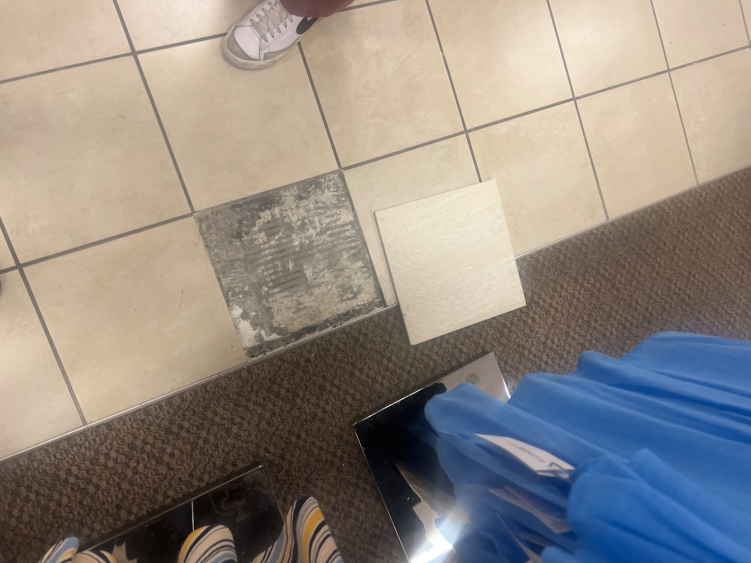
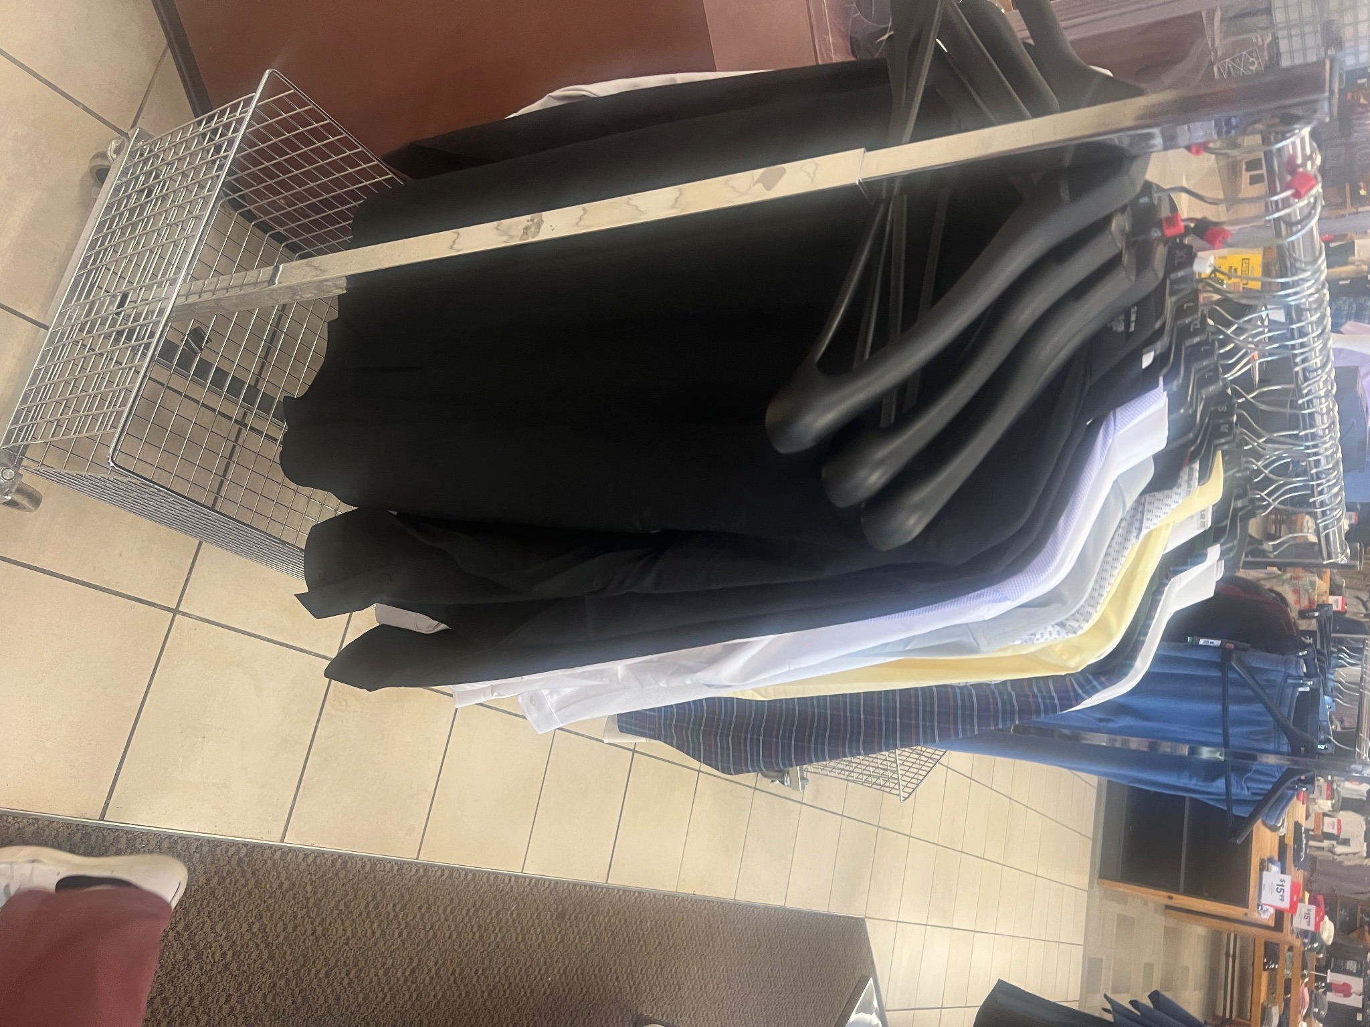

Slide 3
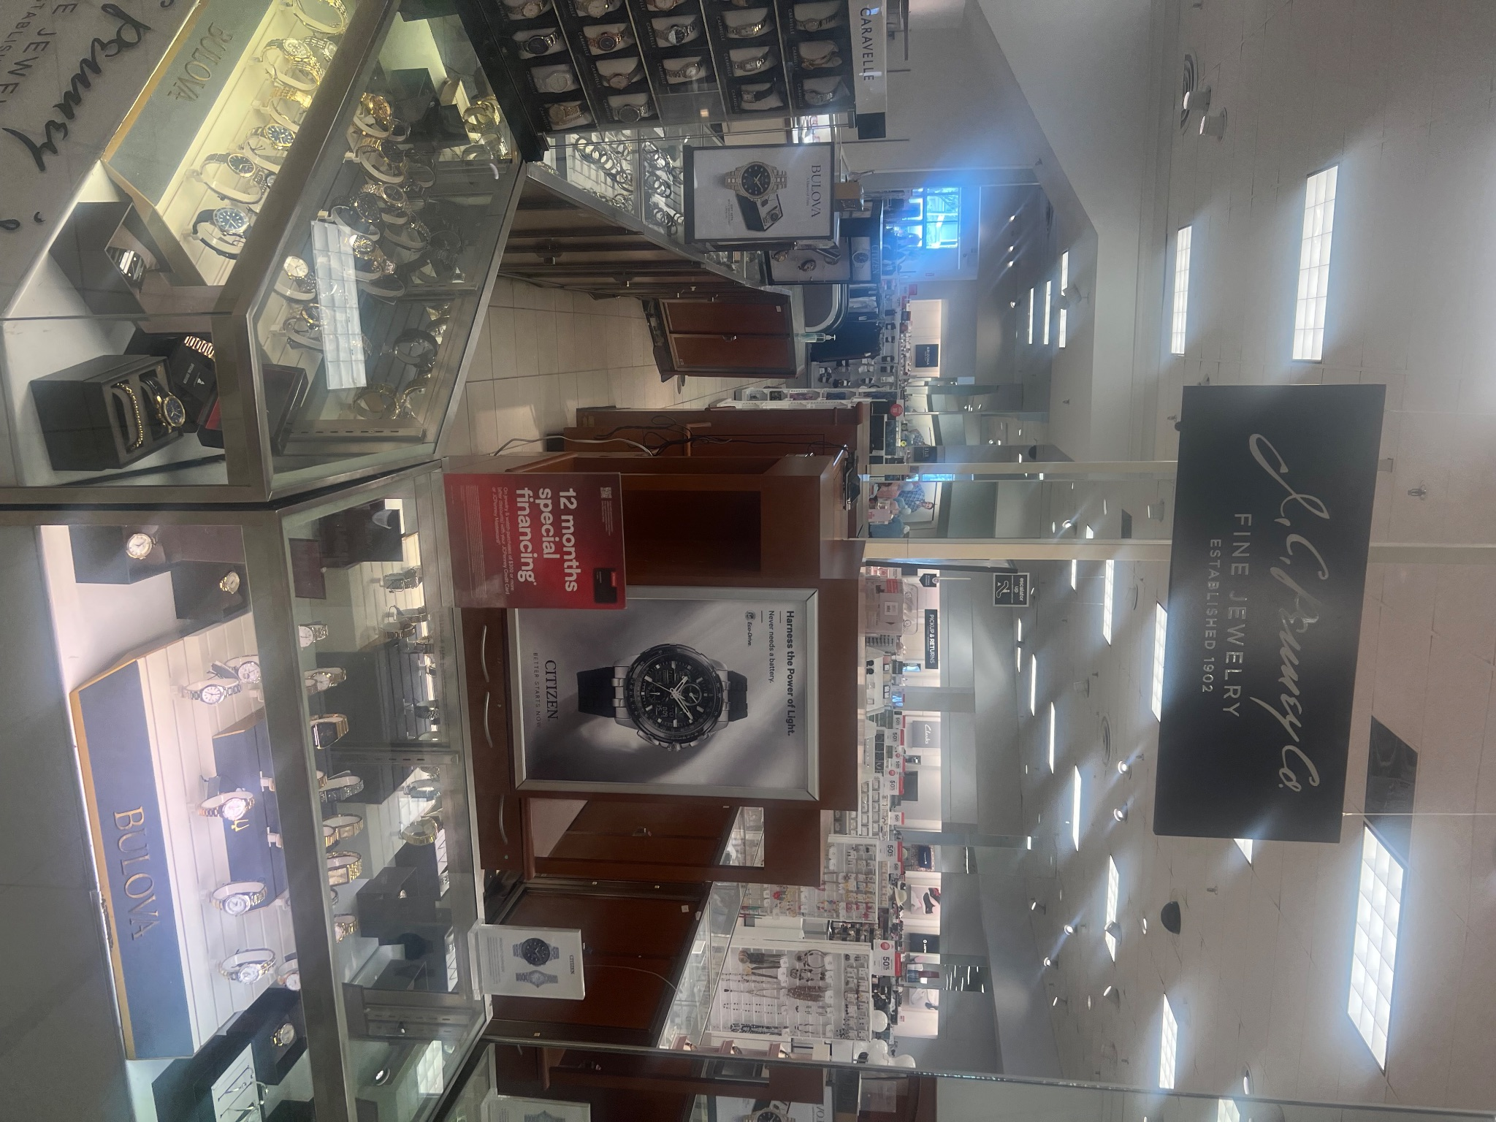

Slide 4
01
Project Scope
CONTENTS
02
Marketing Research
03
Recommended Segmentation and Targeting
04
Recommended Positioning
05
Recommended Branding
06
Marketing Objective and Strategies
07
Tactical Planning

Slide 5
01 - Project Scope
Strategic goals, marketing objectives, and supportive tactics to turn around the recent downfall of the mass merchandiser.
Our Recommendations
Revolve around customer retention and acquisition
Include:
Layout changes, cutting production, and training for sales representatives.

Slide 6
02 - Marketing Research
Introduction to JCPenney
Mid-range or low-cost department store category.
One of the largest department stores in the United States,
Excellent products at accessible prices, diverse assortment of clothes, accessories, and home goods.
JCPenney competes with other mid-range department stores like Macy's, but it is also a direct rival of mass merchandisers like Amazon and Walmart.

Slide 7
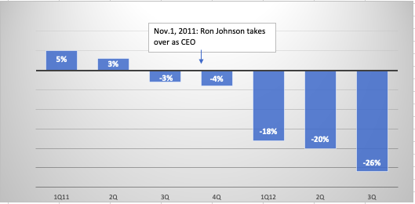
02 - Marketing Research
INSIGHT #1
“JCPenney has had failed CEOs and Marketing Strategies over the last decade, which caused a drastic downward spiral in loss in profit, sales & customer retention.“
Inability to acquire a CEO that fully understands the mechanics
Each CEO has taken different approaches
The COVID-19 pandemic
JCPenney wasn't ready for a full transition to online retailing
General Merchandising Manager

Slide 8
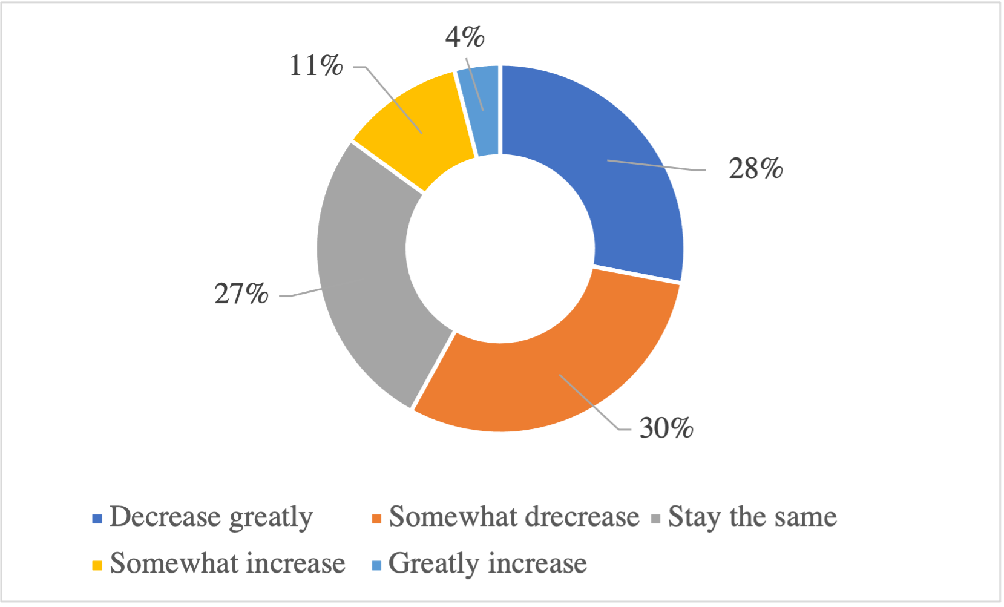
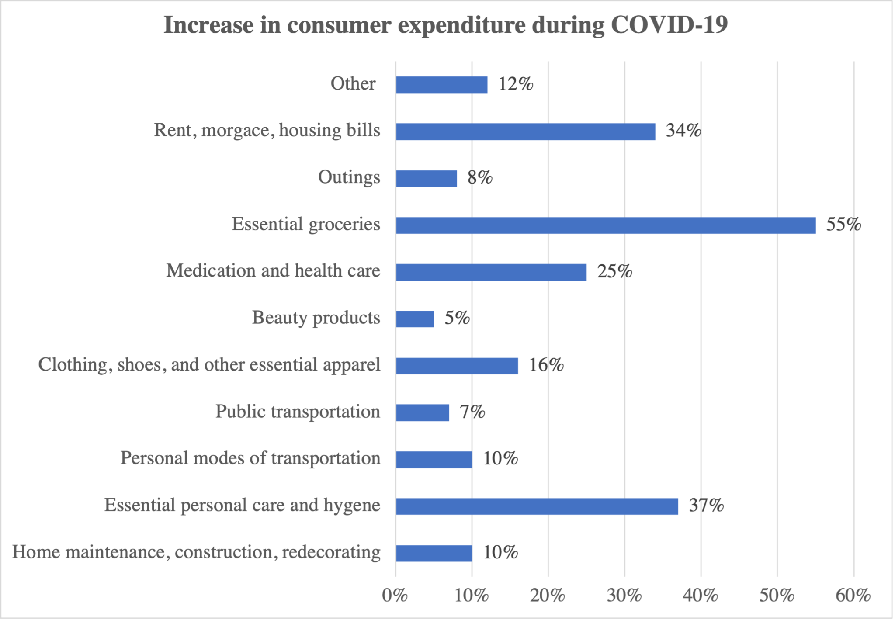
02 - Marketing Research
INSIGHT #2
“The biggest threat to retailers was not specifically the competitors, but rather the threat of a recession that will cause consumers to choose cheaper and more attainable brands, especially through e-commerce, as a result of the COVID-19 lockdown.”
Retailers feel more discouraged → Survey
More than half would decrease their expenditures.
More retailers jumped on the retail media network bandwagon
Undercutting by selling ar bargain prices.

Slide 9
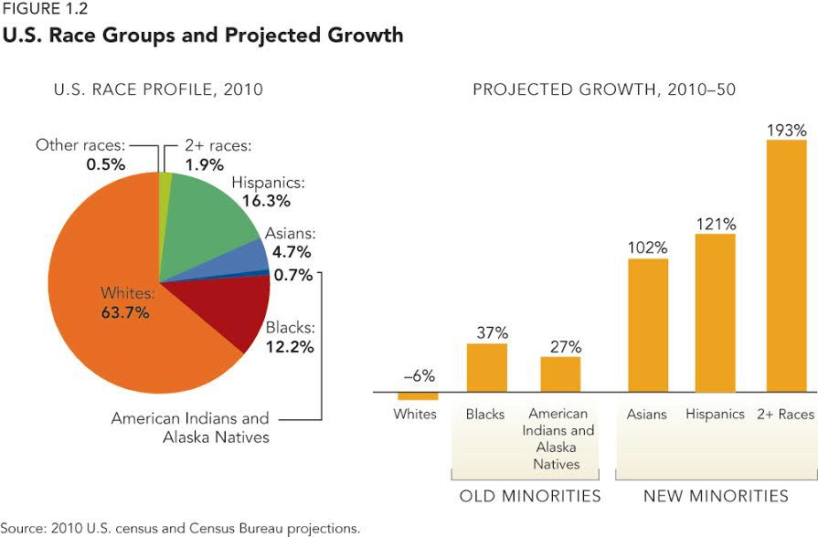
02 - Marketing Research
INSIGHT #3
“As socio demographics are changing among the general public and society demands better deals, some retail stores must invest in competitive omnichannel strategies in order to promote innovation and consumer loyalty.”
Individuals are becoming more diverse and open-minded →Multiracial
Disloyalty to brands
Come back to physical stores to further and deepen relationships with consumers.
As many consumer channels as possible to ensure brand awareness and increase visibility.
Same-day pickup/delivery, metaverse stores, payment plans

Slide 10
02 - Marketing Research
Business Problem
Sales are decreasing in J.C Penney because consumers fear a potential recession, they demand better deals, and JCPenney’s inability to innovate.
Root Causes
Consumers are dissatisfied with the lack of innovation and maintenance
Consumers look for convenience and just-in-time products.
Customers are dissatisfied with the department store industry.

Slide 11
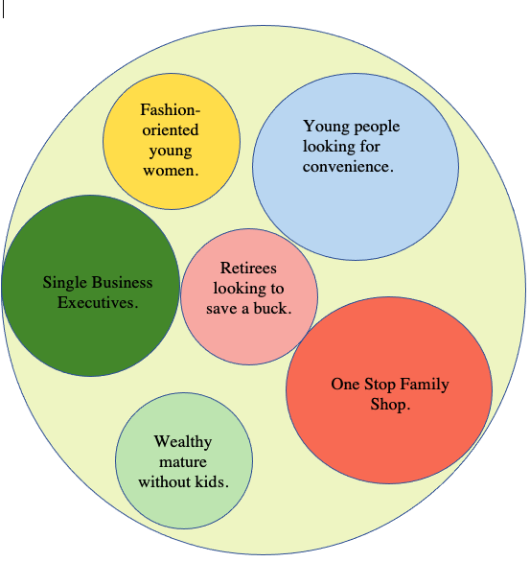
03 Segmentation

Slide 12
Target Customer(s) Definition and Profiles
Consumer Segment | Product Offering
Consumer Segment #1: Young Female-Fashion oriented Women | Product Offering #1: Apparel Designed to attract woman of all sizes and shapes, and the clothing best fits women’s generational needs and wants .
 | Not part of our Target Market
Consumer Segment #3: One-Stop Family Shop | Product Offering #2: Cost-Effective, Promotion and Discount-Oriented Household Items, Appliances and Kids Clothing.
 | Not part of our Target Market
Consumer Segment #5: Young People looking for convenience | Product Offering #3: Suits, Dresses, Shoes, and Ties that are reasonably priced for a last-minute professional presentation, work, conference, or interview.
Consumer Segment #6: | Not part of our Target Market

Slide 13
Positioning Statements
To the One Stop Family Shop, JCPenney is a seasonable and contemporary mass merchandiser that provides satisfaction and confidence by allowing new homeowners to spruce up their homes and save a few bucks.

Slide 14
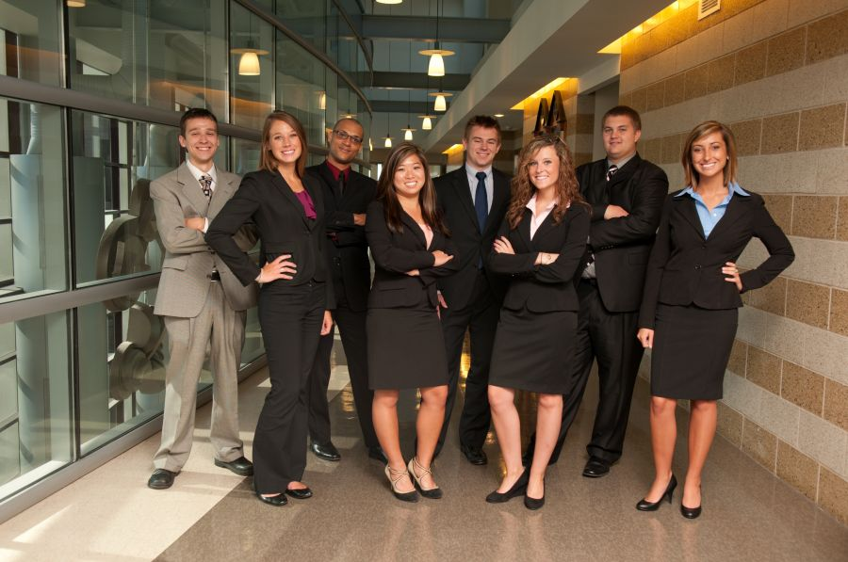
Positioning Statements
To the Young People Looking for Convenience, JCPenney is an affordable and low-cost mass merchandiser that provides convenience and a stress-free environment by allowing Generation Z to find a suit and tie and a high inventory of bundled clothing

Slide 15
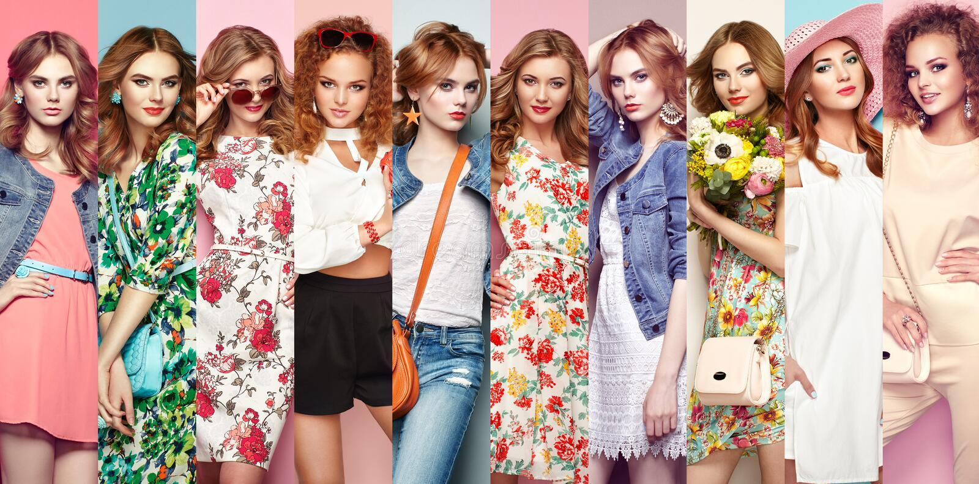
Positioning Statements
To the Young-Female Fashion-oriented Woman, JCPenney is a fashionable, contemporary, and in-style mass merchandiser that provides an encouraging and open environment by allowing Every single Young Female to express themselves with the latest and trendiest clothing and makeup ranging from cool, casual, and cozy to clean-cut, sophisticated and classy.

Slide 16
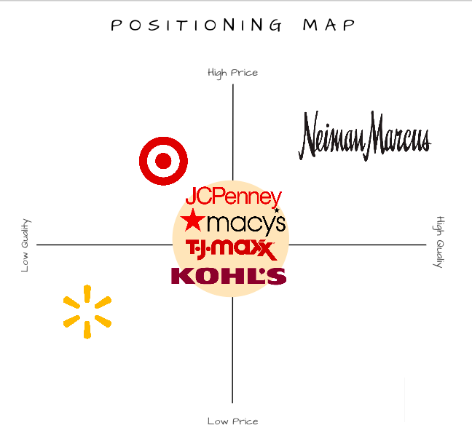
Positioning Map

Slide 17
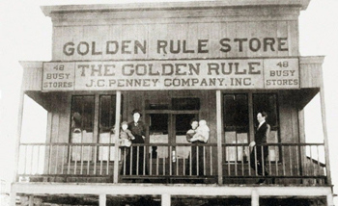
Brand Utility and Identity
-Brand Identity: JCPenney has been part of history for over 100 years (1902) and has been the most popular retailer through multiple economic crises, world wars, and most recently the COVID-19 pandemic. It was the first popular department store/mass merchandiser in the U.S. Other identifiers are red logo, location of the stores, and expected products/services offered.
-Brand Utility: JCPenney wants everyone to get a sense of empowerment, being able to take control of their life, and get everything they need from one place. Penney’s is a trusted American brand, and customers rely on their ongoing product lines they have obtained for years to be consistent and quality.

Slide 18
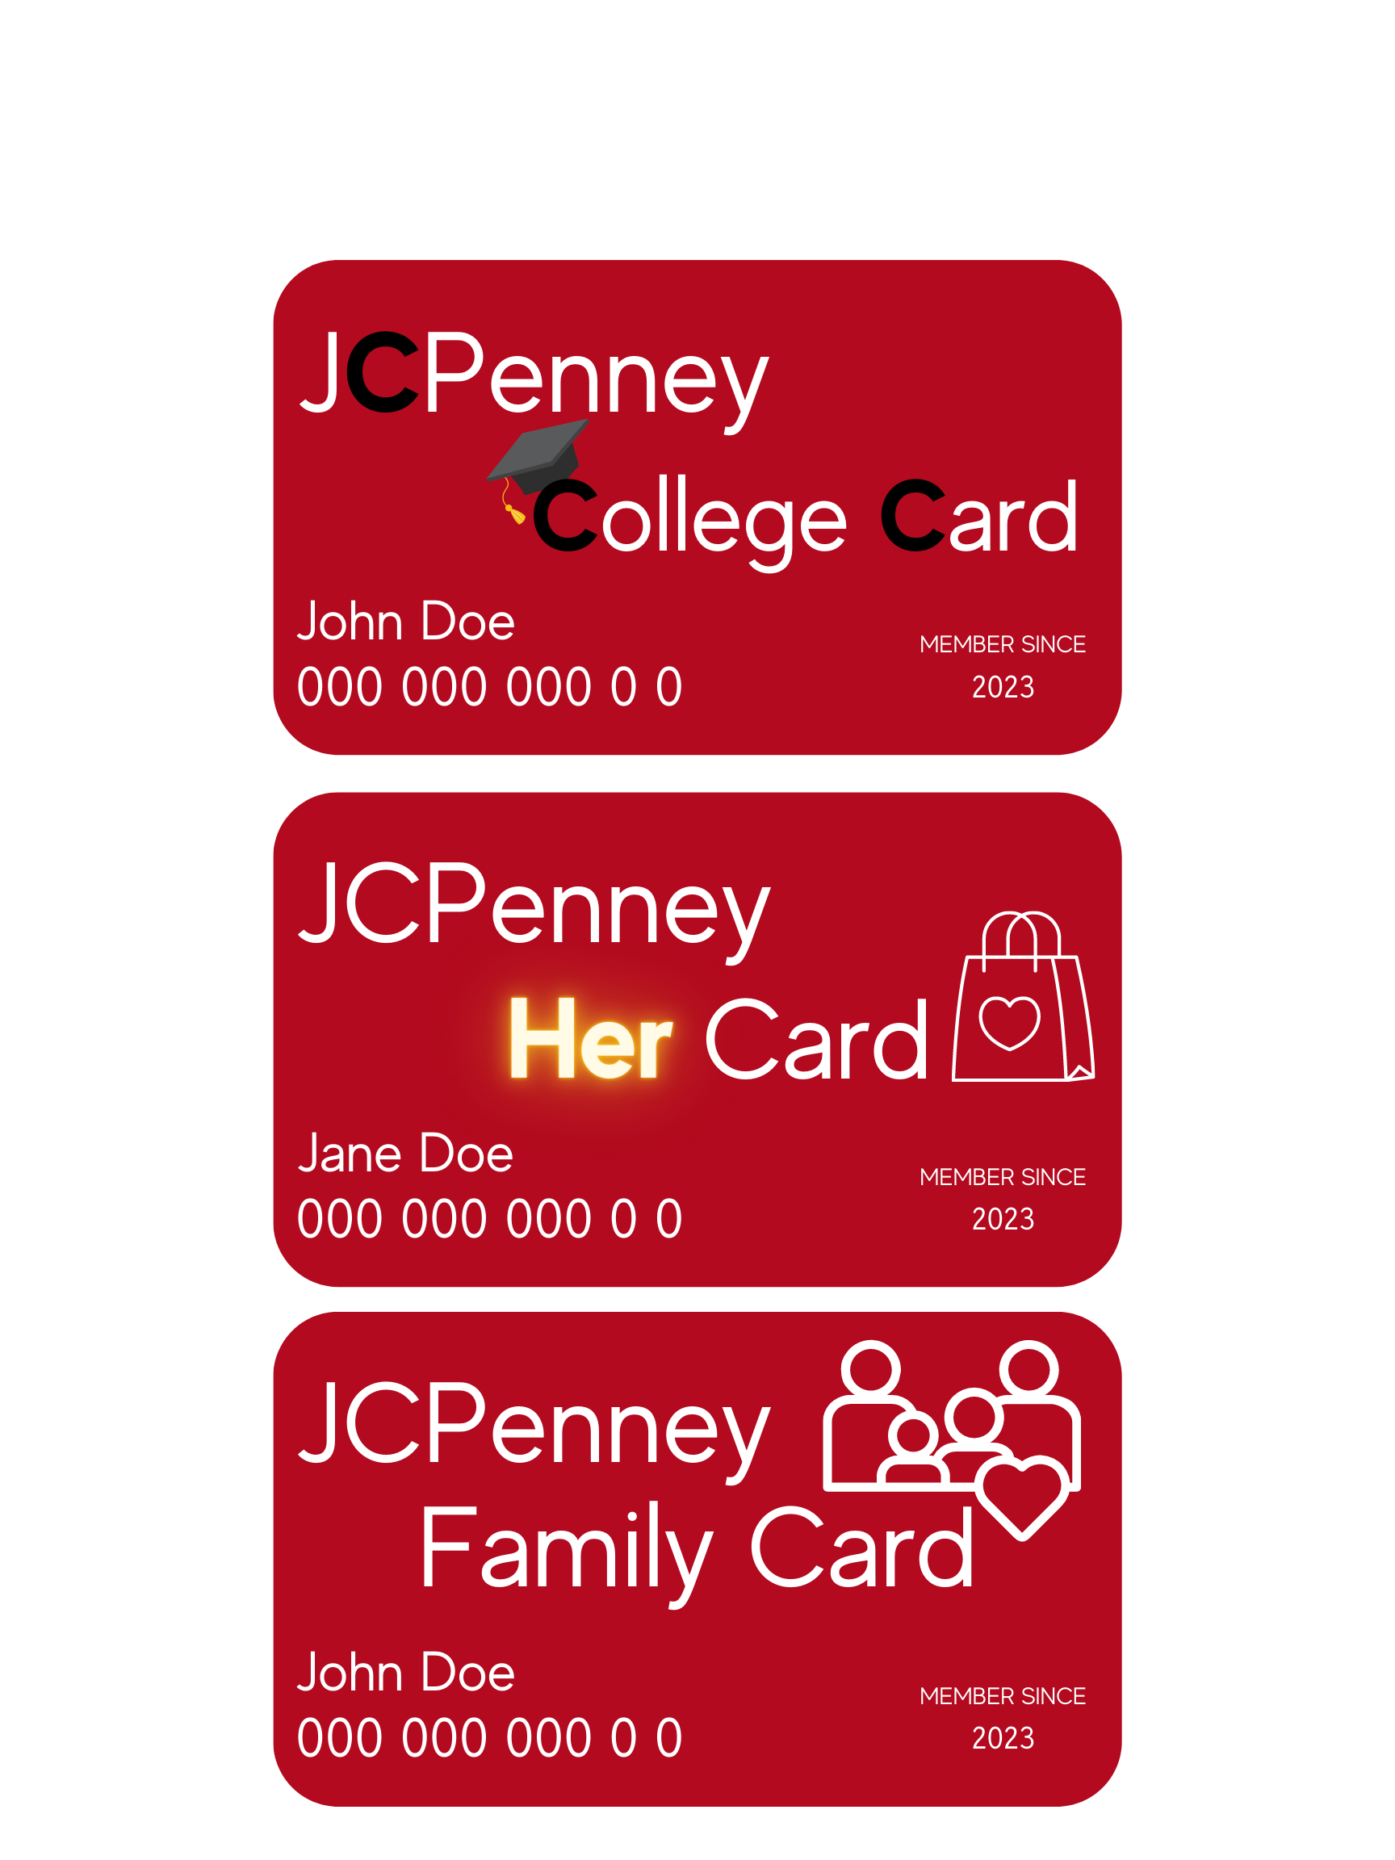
06 - Marketing Objective & Strategies
Objective:
Sales will increase as consumers view JCPenney as innovative, they receive better deals, and perceive greater value in their shopping experiences.
Strategies:
Marketing Mix Action Strategy: generate better social media content and digital presence.
Consumer Benefit provided Strategy: credit-card tier program
Marketing Mix Action Strategy: New store layout plan

Slide 19
10 - Strongest Tactics
Best Tactic for Strategy 1:
Less “UGC”, more originality between post, promotional events
Best Tactics for Strategy 2:
Survey, questionnaire asking about customer preferences
Best Tactic for Strategy 3:
Split Stores, allow accessibility between shopping for clothes or home decor/furnishings

Slide 20
11 - Tactical Matrix

